Slide 1
CSCE 313 – introduction to operating systems
Reading Reference: Textbook Chapter 1
Aakash Tyagi CSCE 313 Spring 2016
January 26, 2016

Slide 2
Before we start our conversation…..
Class Interaction Model
Piazza Enrollment
Please enroll if you haven’t already
Machine Problem 1 is released on Piazza. Details and Logistics will be discussed in the LAB.
Lab Teams – Form your team this week. Tanzir will record the team composition in the LAB.
Midterm will be on March 3
Detailed Lecture Schedule WIP.
Student
Announcements
Quiz, Exams
QnA
MP
Practice Q’s
Grades
Lecture
Material
Teaching Assistant
QnA
Instructor
Color Key
RED: Piazza
BLUE: Vocareum
BLACK: Paper
Purple: eCampus

Slide 3
Quick Recap from Jan-21 Discussion
Operating Systems (OS) - while used in “technological terms” as an entity associated with Computer Systems – are present in (and inspired by) things surrounding our daily lives
Computer Systems are generalized as a macrocosm of hardware, operating system, applications, and users
OS is the most important component of System Software
REFEREE, ILLUSIONIST, and GLUE

Slide 4
Introduction to OSs
Today, we will cover some basic background of Computer Systems and then get into a bit of historical context and challenges to appreciate how OS’s have transformed with Evolution of Technology and System Complexity

Slide 5
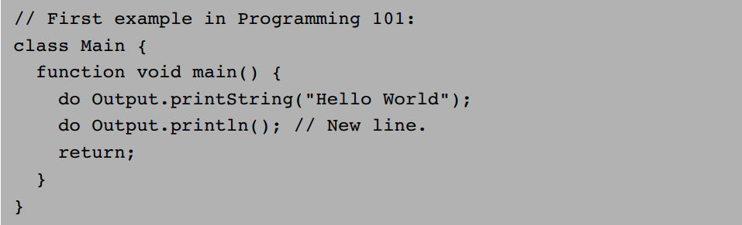
Hello World
What does it take to run the above program on a computer?
First: parse this text, uncover its semantics, and re-express it in some low-level language understood by our computer (Compile)
Second: this low-level language must be understood by something underneath (hardware architecture)
Third: the hardware architecture (just like a building) must be composed of ‘gates’ and ‘flops’ (bricks) ☺
Fourth: the gates and flops must be built out of switching devices (just like clay to build bricks)

Slide 6
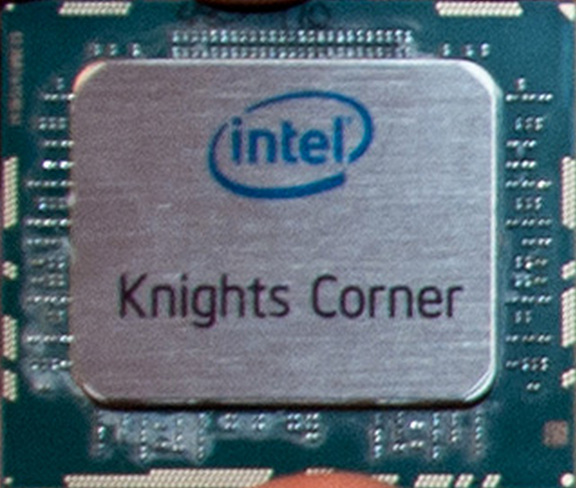
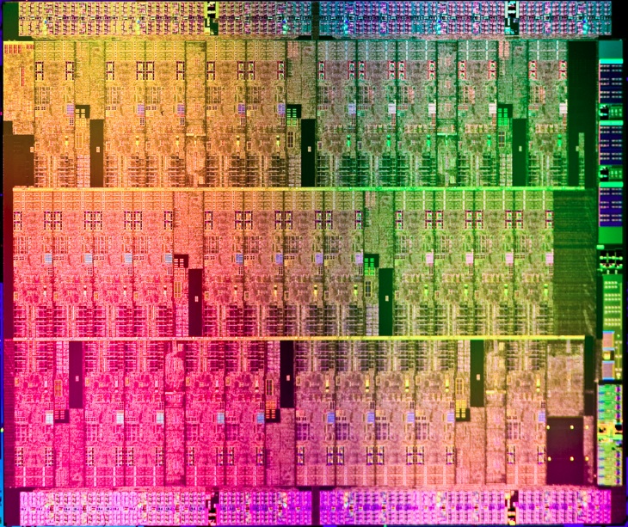
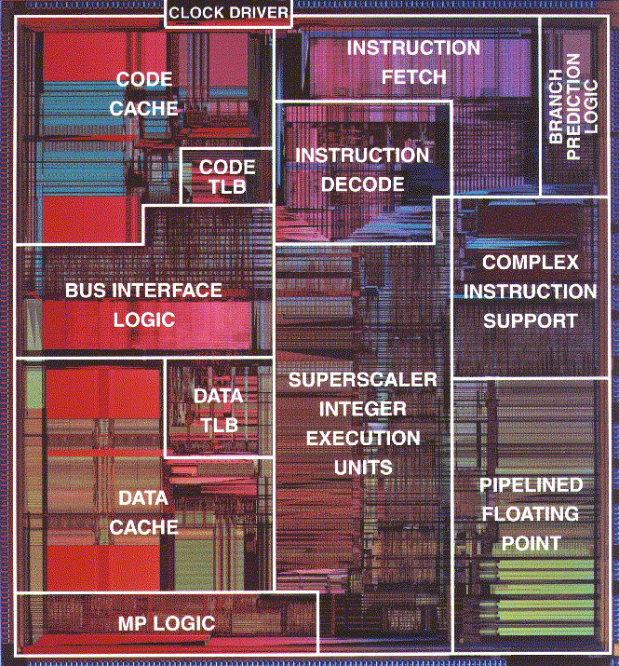

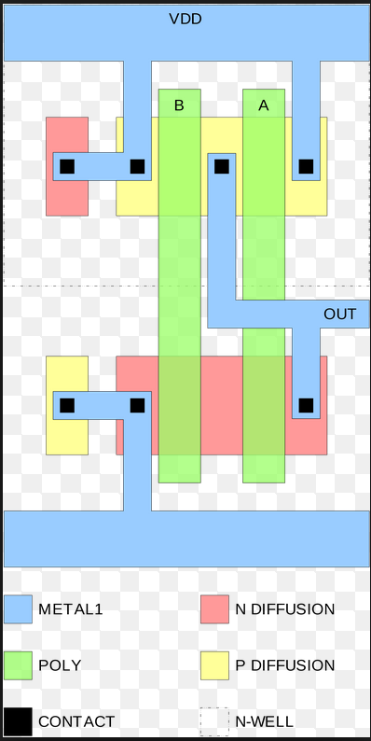
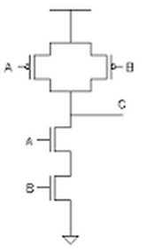
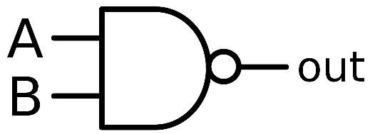
What does a computer really look like inside
Single Core
And this is what a NAND gate
looks when sent to the MASK
shop to get fabricated!
Core is made of millions
of such gates
This is what a NAND gate
looks like inside at switch level

Slide 7
Abstractions
We wonder how such complex systems can be built with nothing more than simple logic gates or intersecting polygons of silicon
We deal with this complexity by breaking the system into modules, and treating each module separately, in a standalone fashion, in any order!
This strategy works well thanks to a special gift unique to humans: our ability to create and use abstractions
Rely on the “what” instead of the “how”
The multi-tier collection of abstractions underlying the design of a computing system can be described top-down, showing how high-level abstractions can be expressed by simpler ones
This structure can also be described bottom-up

Slide 8
The BIG PICTURE
Human
Abstract design
Software
Thought
abstract interface
hierarchy
H.L. Language
Compiler
&
abstract interface
Operating Sys.
Virtual
VM Translator
Machine
abstract interface
Assembly
Language
Assembler
abstract interface
Computer
Machine
Architecture
Language
abstract interface
Hardware
Gate Logic
Platform
abstract interface
Electrical
Hardware
Chips &
Engineering
Logic Gates
Physics
hierarchy
(Abstraction–implementation paradigm)

Slide 9
Application level: Pong (example app)

Slide 10
High-level programming (‘toy’ High-Level-Language)
/** A Graphic Bat for a Pong Game */
class Bat {
field int x, y; // screen location of the bat's top-left corner
field int width, height; // bat's width & height
// The class constructor and most of the class methods are omitted
/** Draws (color=true) or erases (color=false) the bat */
method void draw(boolean color) {
do Screen.setColor(color);
do Screen.drawRectangle(x,y,x+width,y+height);
return;
}
/** Moves the bat one step (4 pixels) to the right. */
method void moveR() {
do draw(false); // erase the bat at the current location
let x = x + 4; // change the bat's X-location
// but don't go beyond the screen's right border
if ((x + width) > 511) {
let x = 511 - width;
}
do draw(true); // re-draw the bat in the new location
return;
}
}
Typical call to an OS method

Slide 11
Operating system level (‘toy’ OS)
/** An OS-level screen driver that abstracts the computer's physical screen */
class Screen {
static boolean currentColor; // the current color
// The Screen class is a collection of methods, each implementing one
// abstract screen-oriented operation. Most of this code is omitted.
/** Draws a rectangle in the current color. */
// the rectangle's top left corner is anchored at screen location (x0,y0)
// and its width and length are x1 and y1, respectively.
function void drawRectangle(int x0, int y0, int x1, int y1) {
var int x, y;
let x = x0;
while (x < x1) {
let y = y0;
while(y < y1) {
do Screen.drawPixel(x,y);
let y = y+1;
}
let x = x+1;
}
}
}

Slide 12
Early Operating Systems: Computers Very Expensive
One application at a time
Had complete control of hardware
Users would stand in line to use the computer
OS was runtime library
Batch systems
Keep CPU busy by having a queue of jobs
OS would load next job while current one runs (DMA – Direct Memory Access capability)
Users would submit jobs, and wait, and wait, and …….
Notes:
And wait…

Slide 13
Time-Sharing Operating Systems: Computers and People Expensive
Multiple users on computer at the ‘same time’
Timesharing: round-robin or similar method of CPU ‘visiting’ each program in execution
Multiprogramming: run multiple programs at same time
As computers became cheaper, more important to optimize for user time, not computer time

Slide 14
Today’s Operating Systems: Computers Cheap
Smartphones
Embedded systems
Web servers
Laptops
Tablets
Virtual machines
…

Slide 15
OS History
Notes:
Walk through some of the connections: Windows dragged in some tech from VMS and UNIX

Slide 16
Tomorrow’s Operating Systems
Giant-scale data centers
Increasing numbers of processors per computer
Increasing numbers of computers per user
Very large scale storage

Slide 17



What is an Operating System?
Referee
Manage sharing of resources, Protection, Isolation
Resource allocation, isolation, communication
Illusionist
Provide clean, easy to use abstractions of physical resources
Infinite memory, dedicated machine
Masking limitations, virtualization
Glue
Common services
Storage, Window system, Networking
Sharing, Authorization
Look and feel

Slide 18
What, then, is an Operating System?
The OS controls and coordinates the use of system resources.
Primary goal: Provide a convenient environment for a user to access the available resources (CPU, memory, I/O)
Provide appropriate abstractions (files, processes, ...)
“virtual machine”
Secondary goal: Efficient operation of the computer system.
Resource Management
Transforming: Create virtual substitutes that are easier to use.
Multiplexing: Create the illusion of multiple resources from a single resource
Scheduling: “Who gets the resource when?”

Slide 19
What an operating system is not
OS is not a language or a compiler
OS is not a command interpreter / window system
OS is not a library of commands
OS is not a set of utilities

Slide 20
OS Challenges
Reliability
Does the system do what it was designed to do?
Availability
What portion of the time is the system working?
Mean Time To Failure (MTTF), Mean Time to Repair
Notes:
An excuse to define some terms!

Slide 21
OS Challenges
Servicability
Simplicity and Ease of system repair and maintenance
Security
An OS needs both a security policy (what is permitted) and an enforcement mechanism (only allow permitted actions)
Can the system be compromised by an attacker?
Privacy: Data is accessible only to authorized users
Notes:
An excuse to define some terms!

Slide 22
OS Challenges
Portability
For programs:
Application programming interface (API)
Abstract machine interface
For the operating system
Hardware abstraction layer

Slide 23
OS Challenges
Performance
Latency/response time
How long does an operation take to complete?
Throughput
How many operations can be done per unit of time?
Overhead
How much extra work is done by the OS?
Fairness
How equal is the performance received by different users?
Predictability
How consistent is the performance over time?

Slide 24
In Conclusion: Learnings from Today
We took a short historical tour of the Operating Systems
We learnt that an Operating System has a unique role to play a “Referee”, “Illusionist”, and a “Glue”
We learnt what an OS “IS” and “IS NOT”
OS Design must address a host of challenges that are only increasing in size and complexity as computing becomes pervasive in every waking moment of our lives

